Slide 1
Sprint Board
Final Project: Front End Application Development With JavaScript
- An Effort By Supriya Puri

Slide 2
About the Project: //redo less verbose
My idea ’Sprint Board’ is based on Kanban Board - one of the tools that can be used to implement Kanban to manage work at a personal or organizational level.
The board visually depicts work at various stages of a process using cards to represent work items and columns to represent each stage of the process.
You can move tasks from one column to another with a `drag and drop` action until they are completed.
Each user can login and create a task list according to the work assigned and then keep a track of his progress.
The Sprint Board helps in visualizing work, limiting work-in-progress and achieving maximum efficiency.

Slide 3
List of tasks for the project completion:
Create a React app using class and functional components.
Use react-router for multi-page applications.
Utilize Firebase’s Realtime Database (RD) and Authentication services in a React application.
Create Login on the ’Home Page’ for users to login using Firebase. Once logged in, redirect to the Board page.
The Board page page will display three different components for the tasks monitored:
- To-do
- In-progress
- Complete
Read and write data to Firebase RD and Apply basic database rules to Firebase RD.
Each Task Card must include a `drag and drop` functionality for the users to update assignment status.
Add Task Card ` functionality to allow users to add new assignments.
Each Task card will have the `Title` and the `Category` related to it.
Edit and Delete options to allow users to edit any task entry.
‘Sign out’ option for users to log out.
The app to be deployed onto a web server and to be publicly accessible.

Slide 4

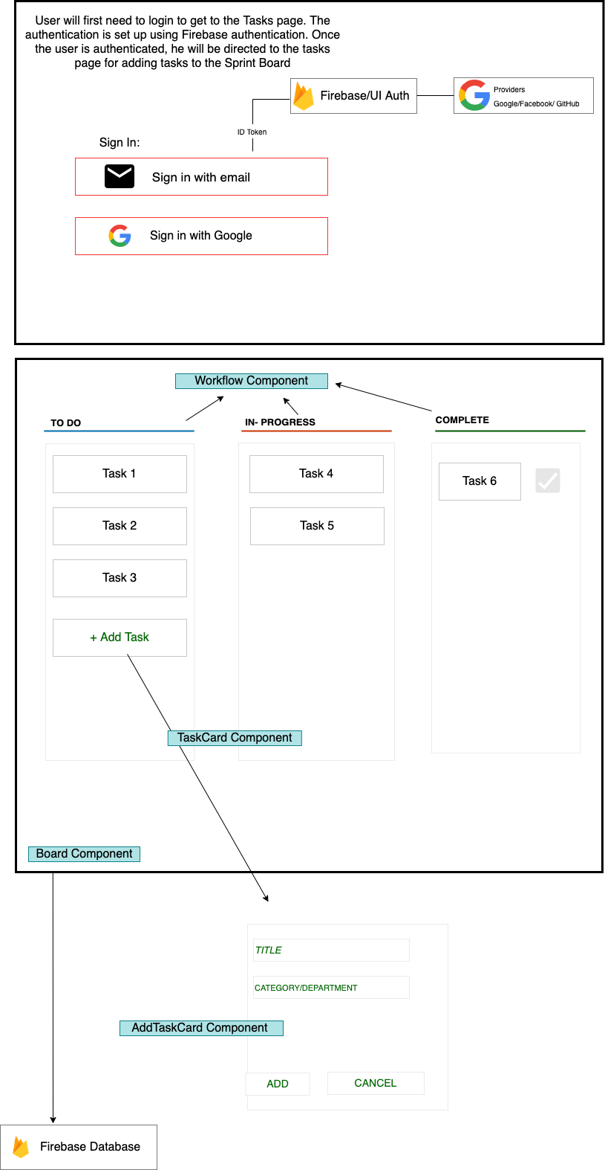
Layout

Slide 5
Demo React application:
App: https://supriyapuri.github.io/sprint-board
GitHub: https://github.com/supriyapuri/sprint-board

